Slide 1
Institutional and Functional Integration under China’s State-orchestrated Regional Cooperation: Yangtze River Delta (YRD)
Zijing (Tina) Zhao & Zekai (Zac) Shen

Slide 2
Introduction & Research Background
Metropolitan areas and urban agglomerations emerging as dynamic units of global competition
Establishing new state space (Brenner, 2004) through state rescaling process
China’s state rescaling: state-orchestrated regional integration strategies aim to address unbalanced regional development
e.g. Yangtze River Delta (YRD), Beijing-Tianjin-Hebei, Guangdong-Hong Kong-Macau Great Bay Area
Inter-city cooperation is a key driver, state pairing well-developed cities with left-behind cities
Effective? Top initiatives conflicts with local needs

Slide 3
Introduction & Research Background
Effective governance depends on the alignment of institutional and functional linkages
Functional linkages, such as labor, capital, information flows, are essential to inter-city cooperation, with population flow serving as a key proxy
Functional linkages often evolve independently of institutional frameworks, creating a lag in policy response, undermining effectiveness of inter-city cooperation
Coupling issues between institutional network space and functional linkage have attracted great attention

Slide 4
Research Question
How do state-orchestrated institutional networks formed by inter-city cooperation respond to dynamic functional linkages, such as population flows?
How do different forms of inter-city cooperation respond to population flow?

Slide 5
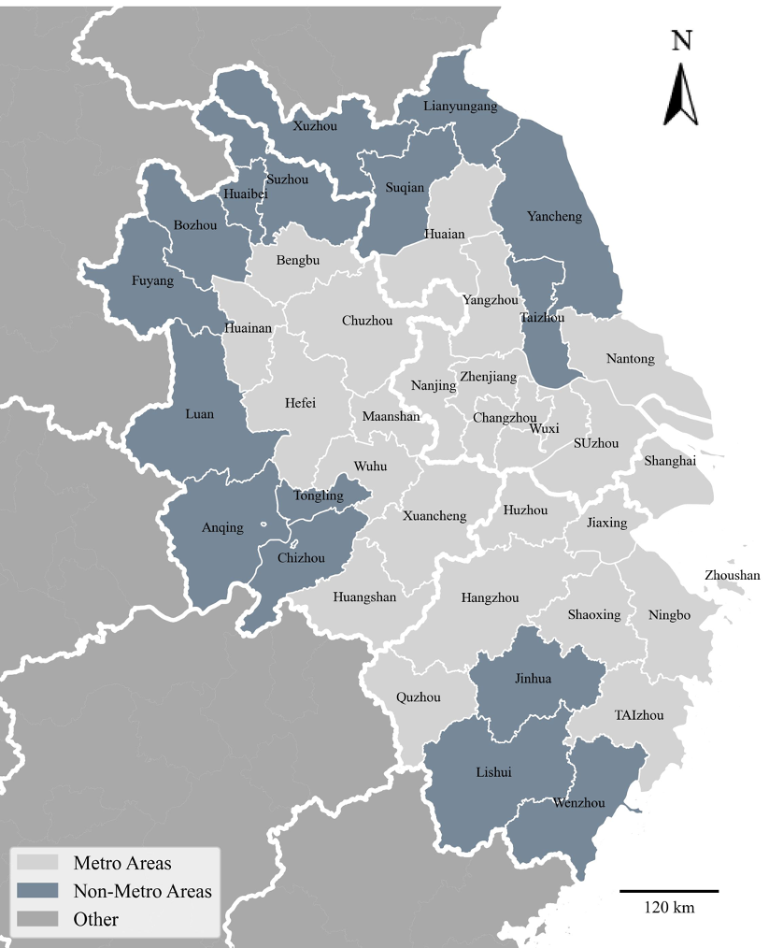
Data
Study Units
Yangtze River Delta (YRD):
Shanghai, Zhejiang Province, Jiangsu Province, Anhui Province
41 cities, 820 city pairs
6-year data in total 2018-2023
Variables
Institutional network space: inter-city cooperation
Web-scrapped 41 cities’ official government website
LLM identify cooperation categories
Functional linkage: population flow
AutoNavi: annual migration index
Data Sources
Cooperation news data from local government websites from 2018-2023 (225075 pieces of news)
AutoNavi platform: inter-city migration index

Slide 6
Interactive Plot
Compare the trend of inter-city cooperation and migration 2018-2023

Slide 7
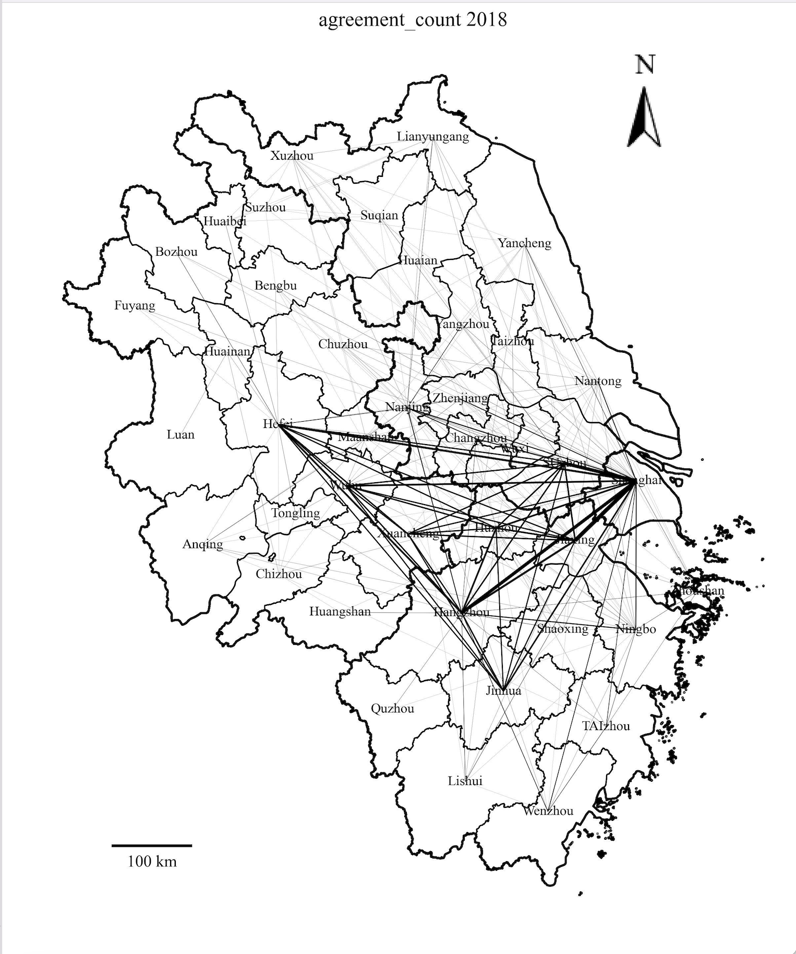
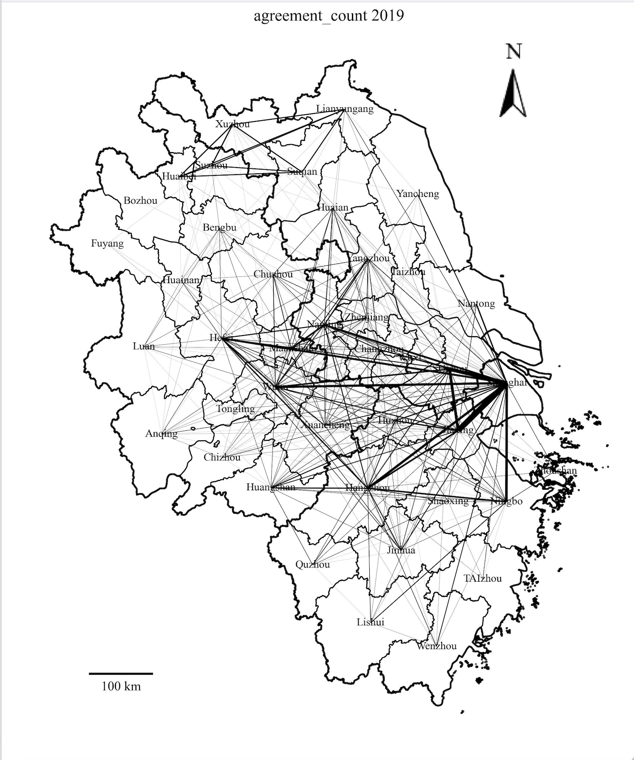
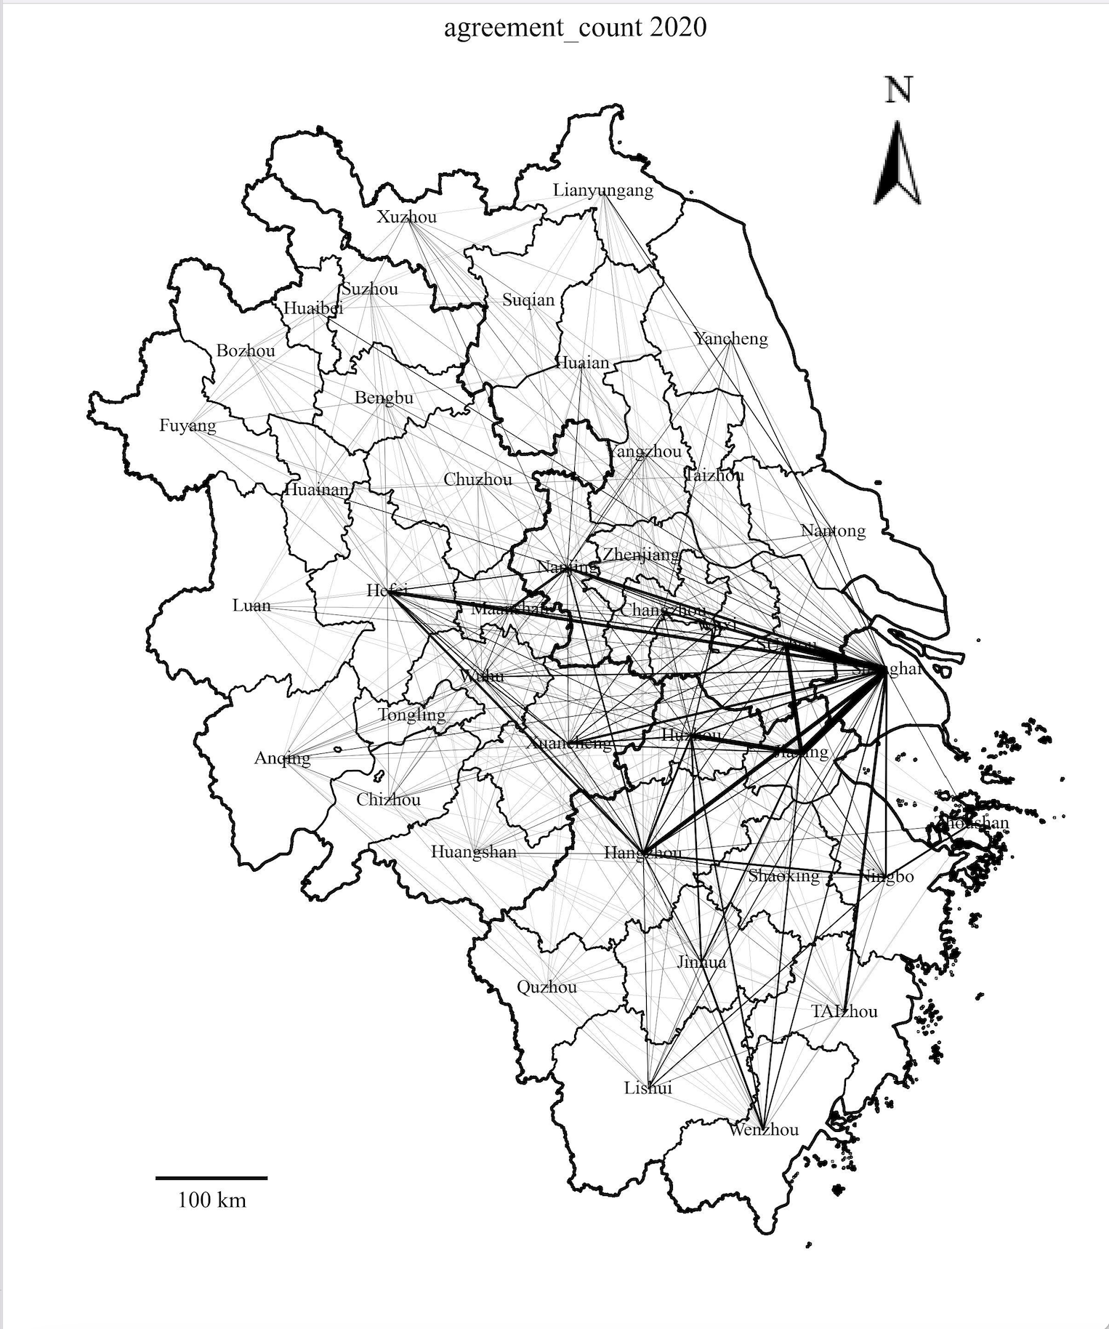
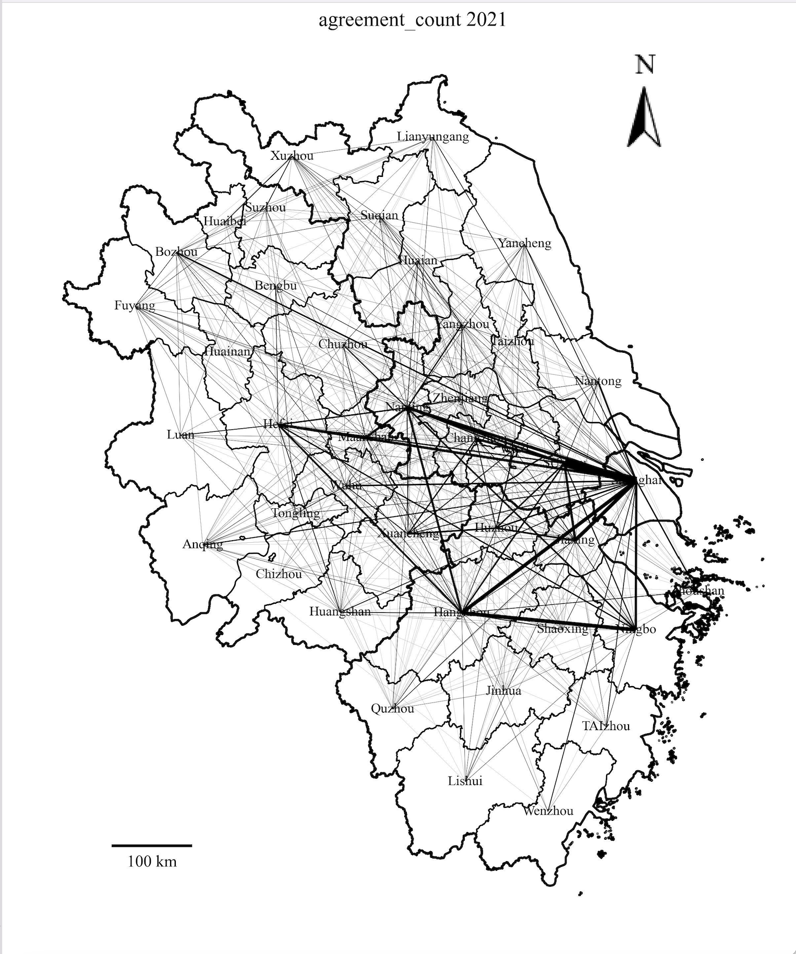
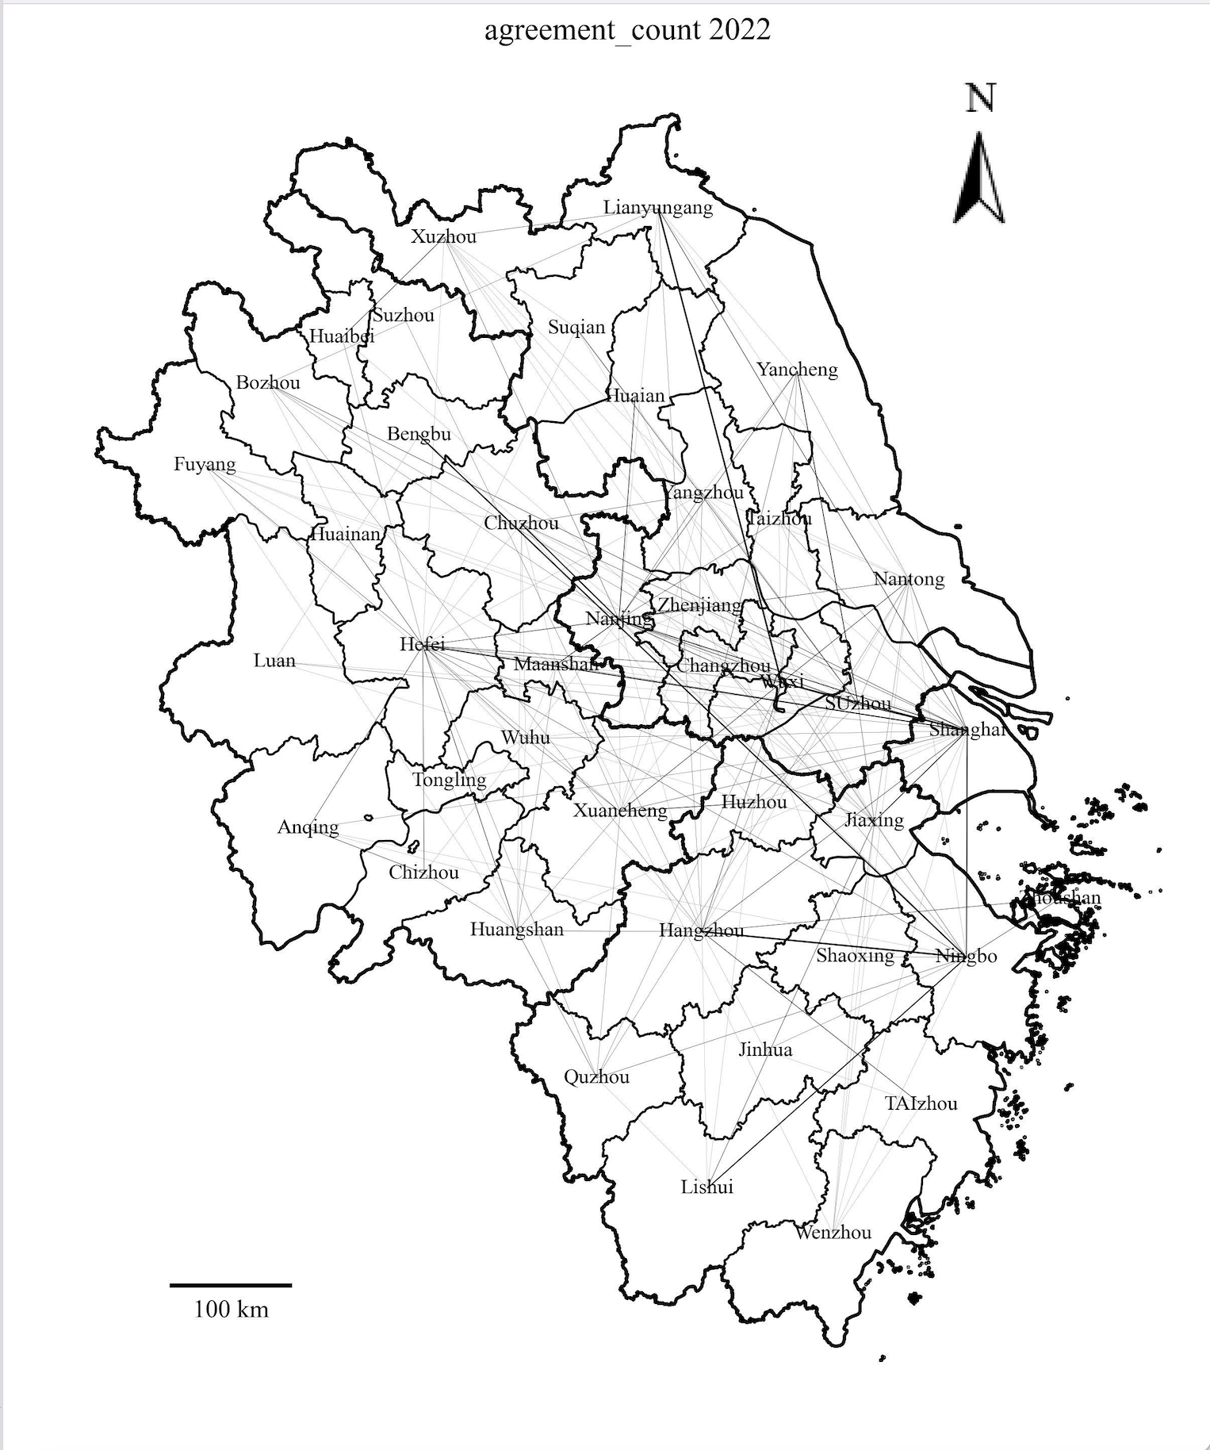
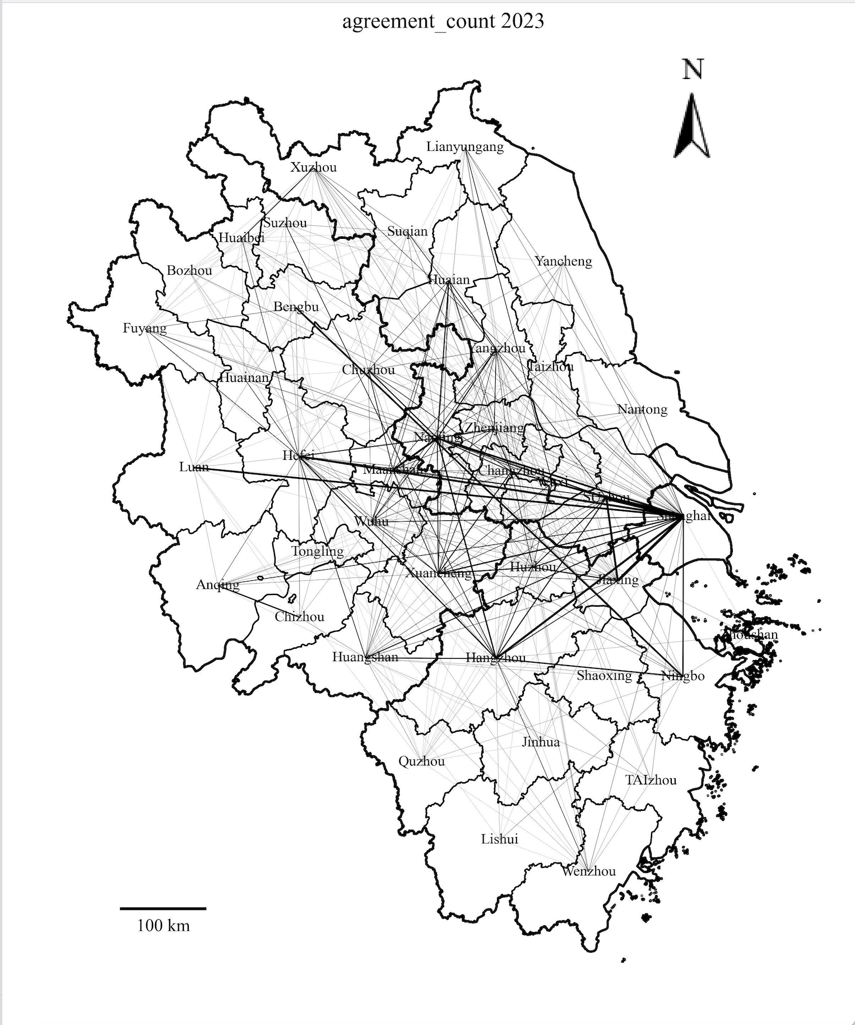
Inter-city Cooperation — Agreement

Slide 8
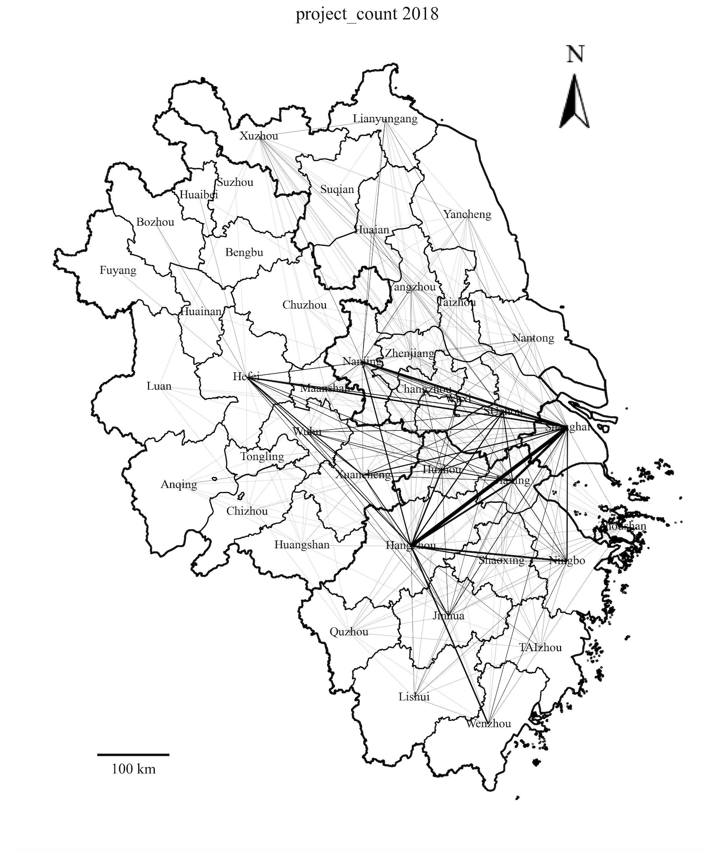
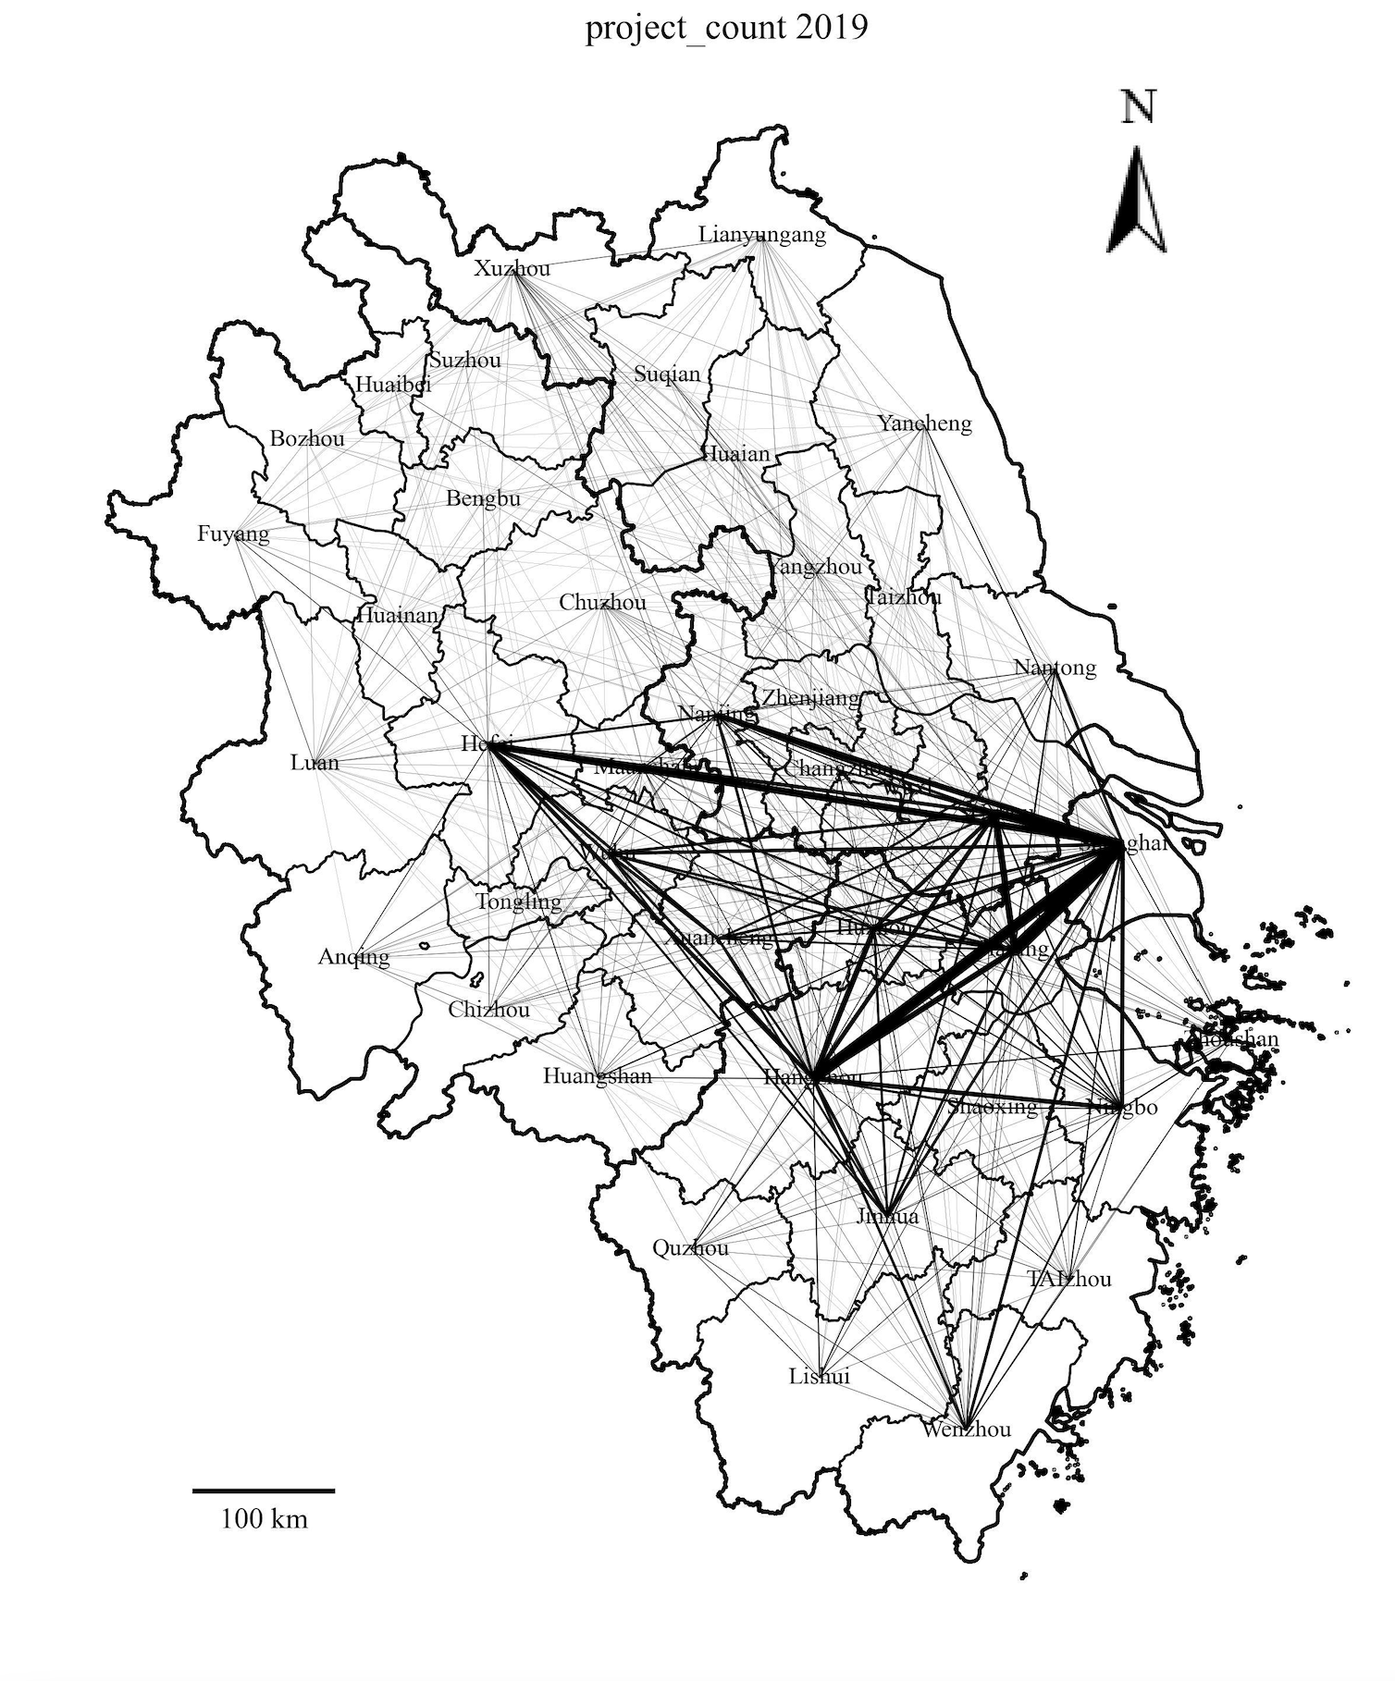
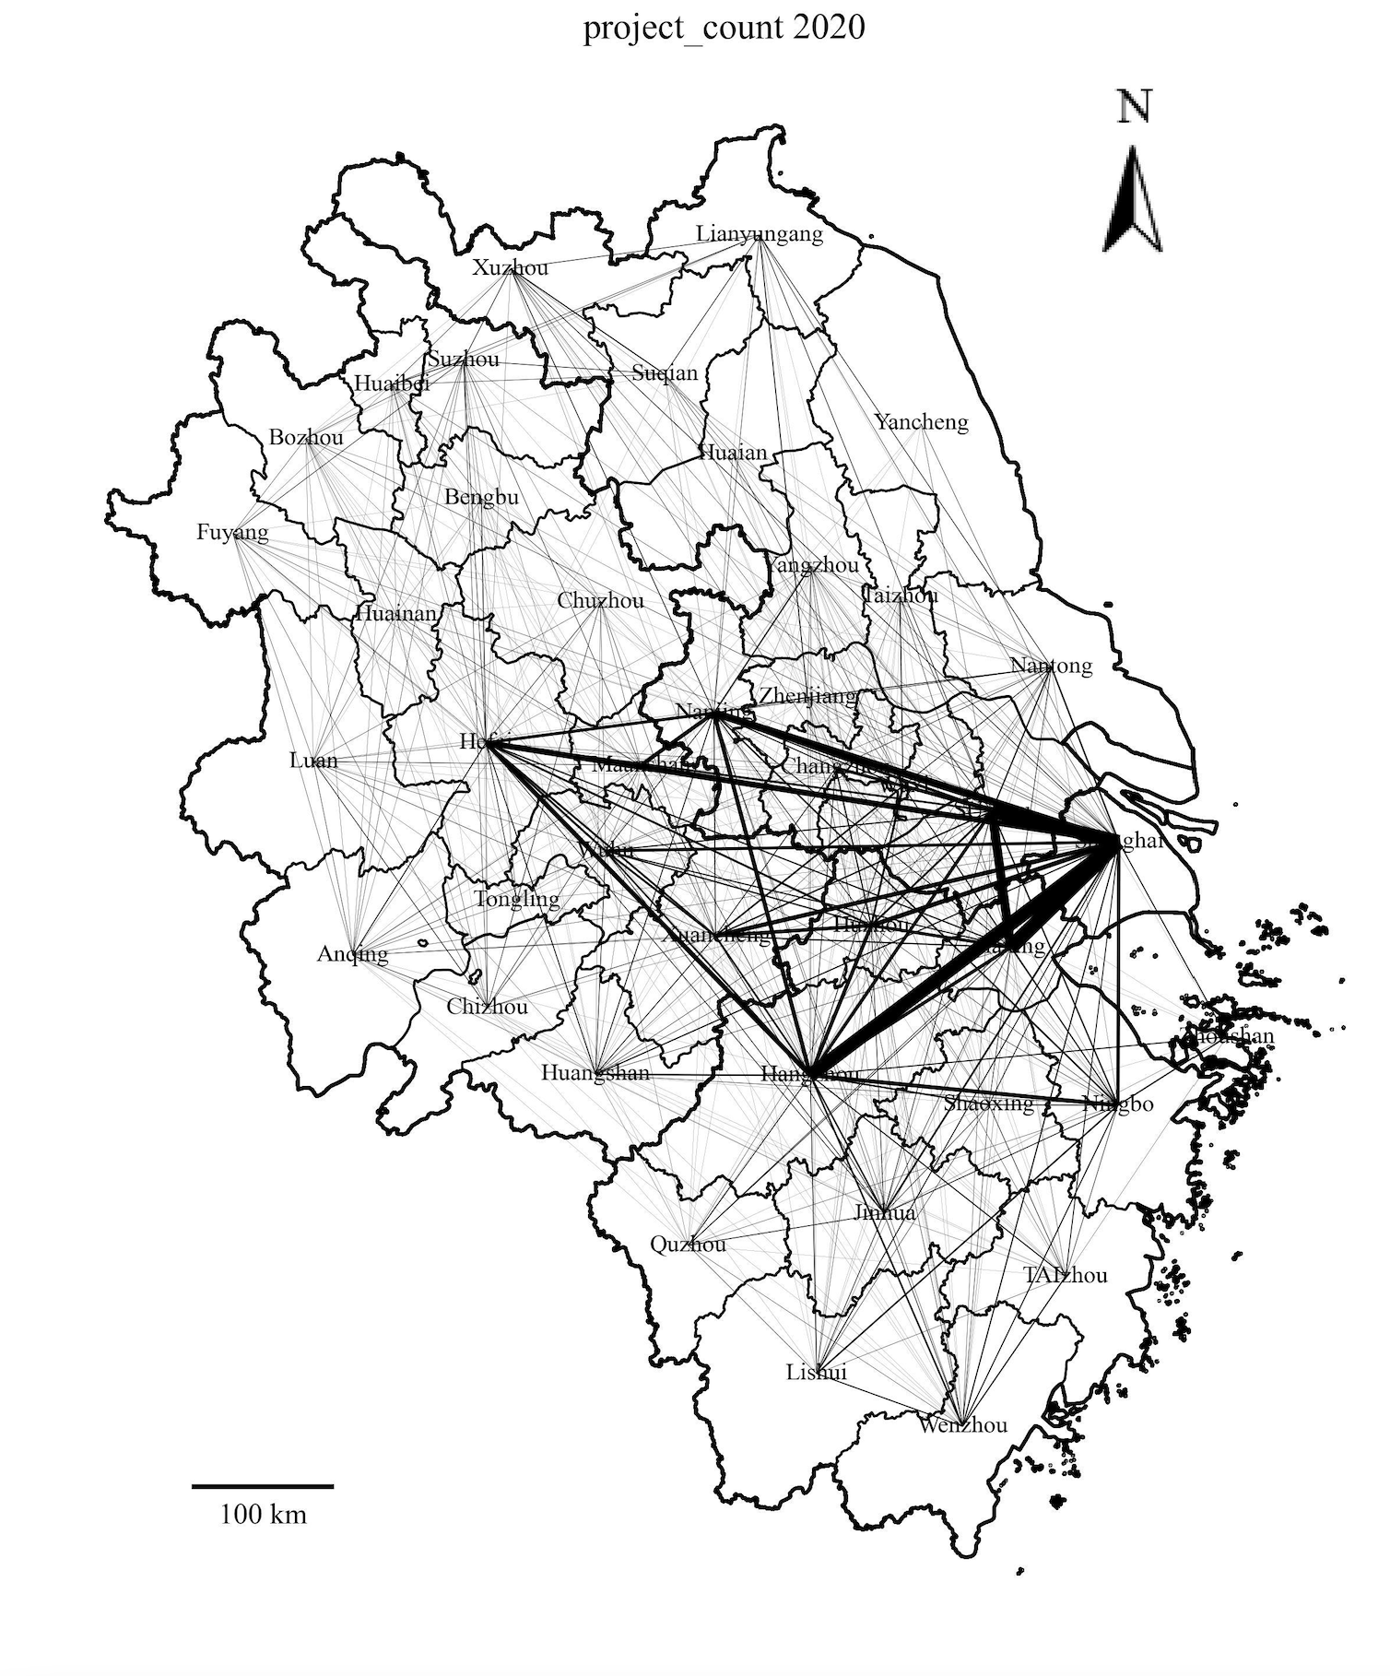
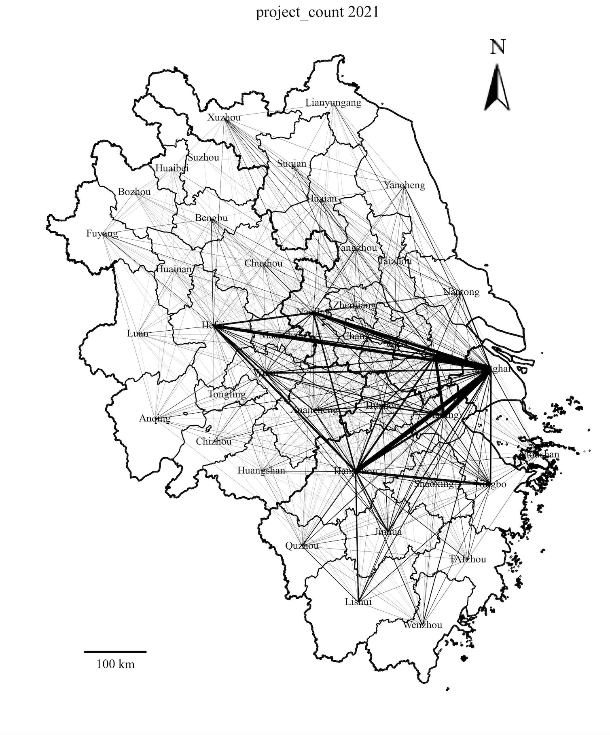
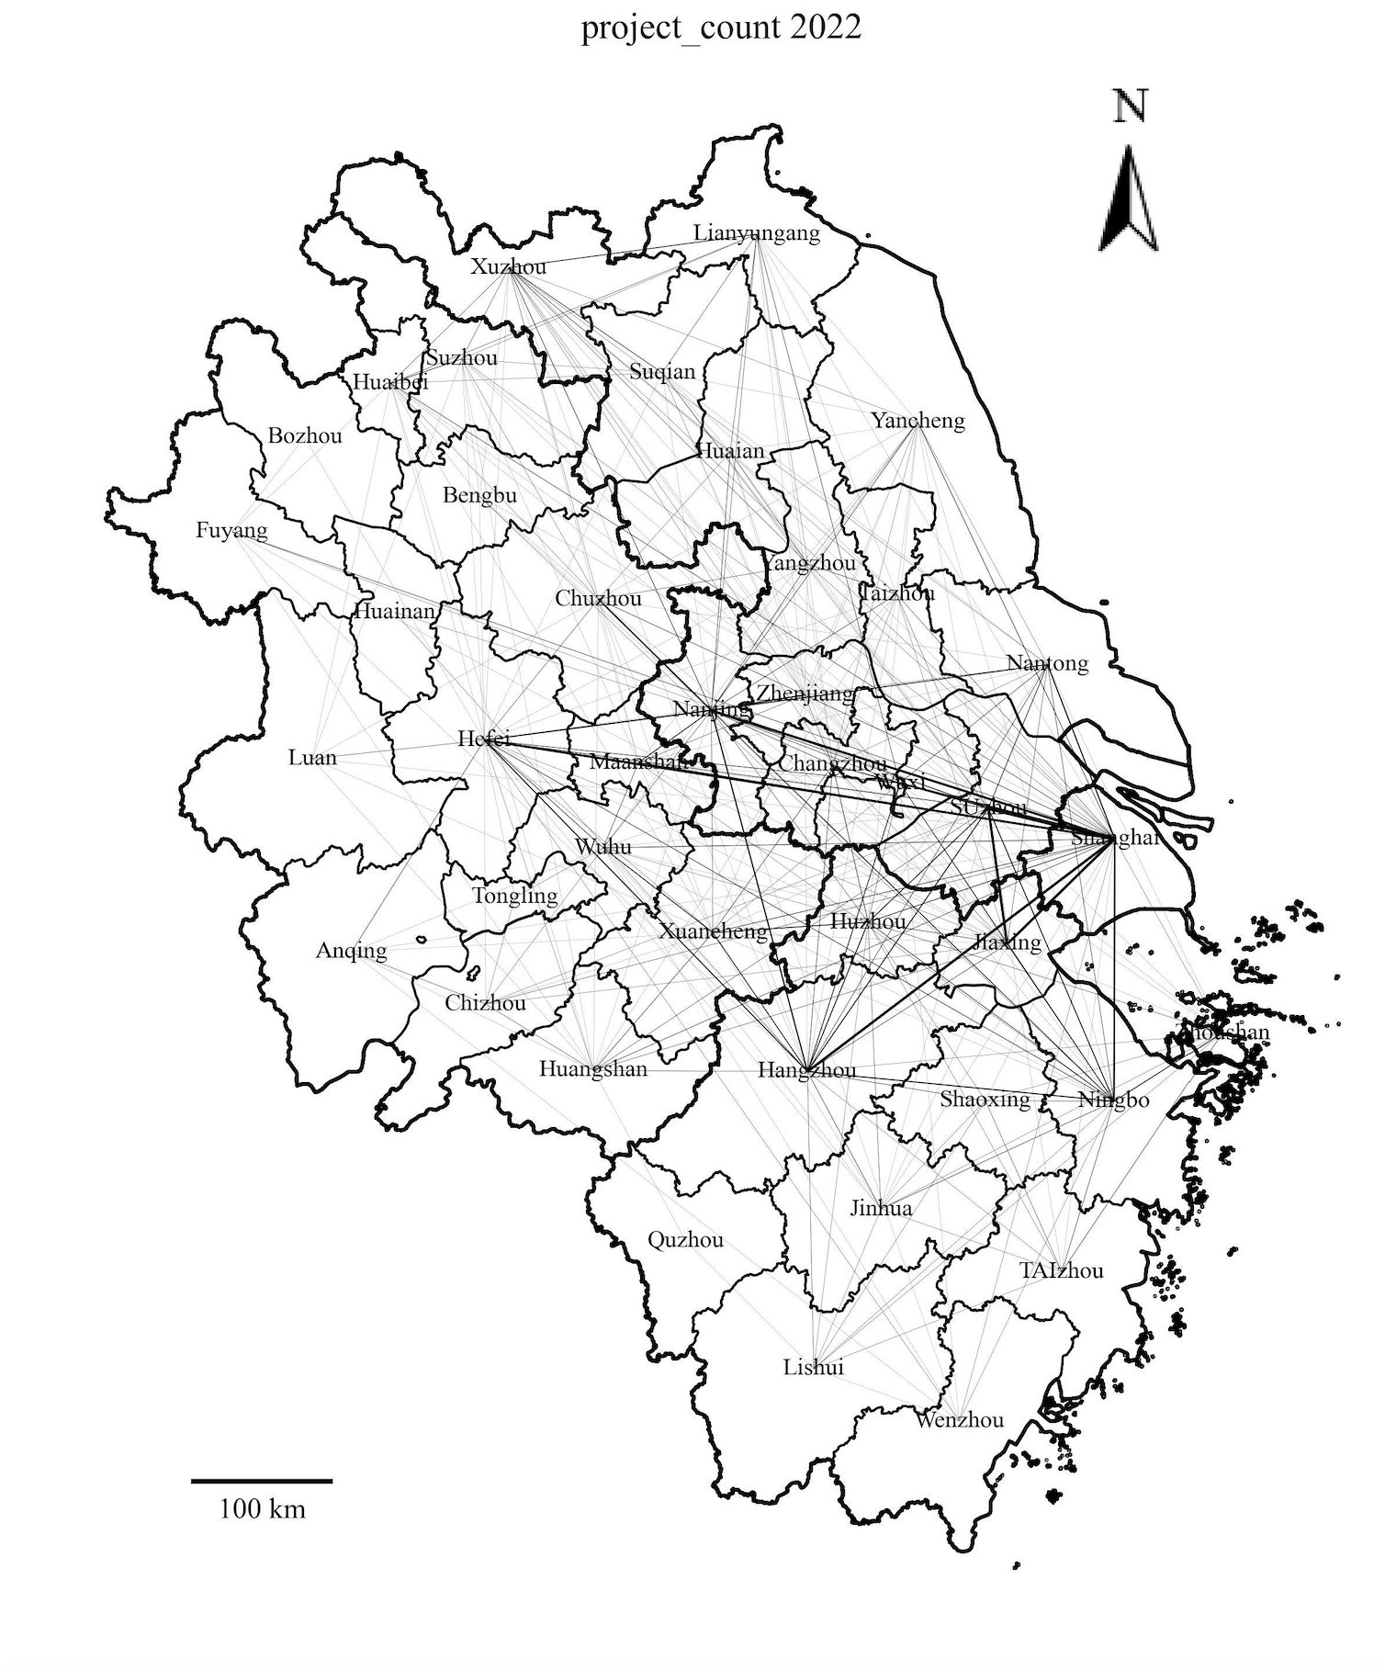
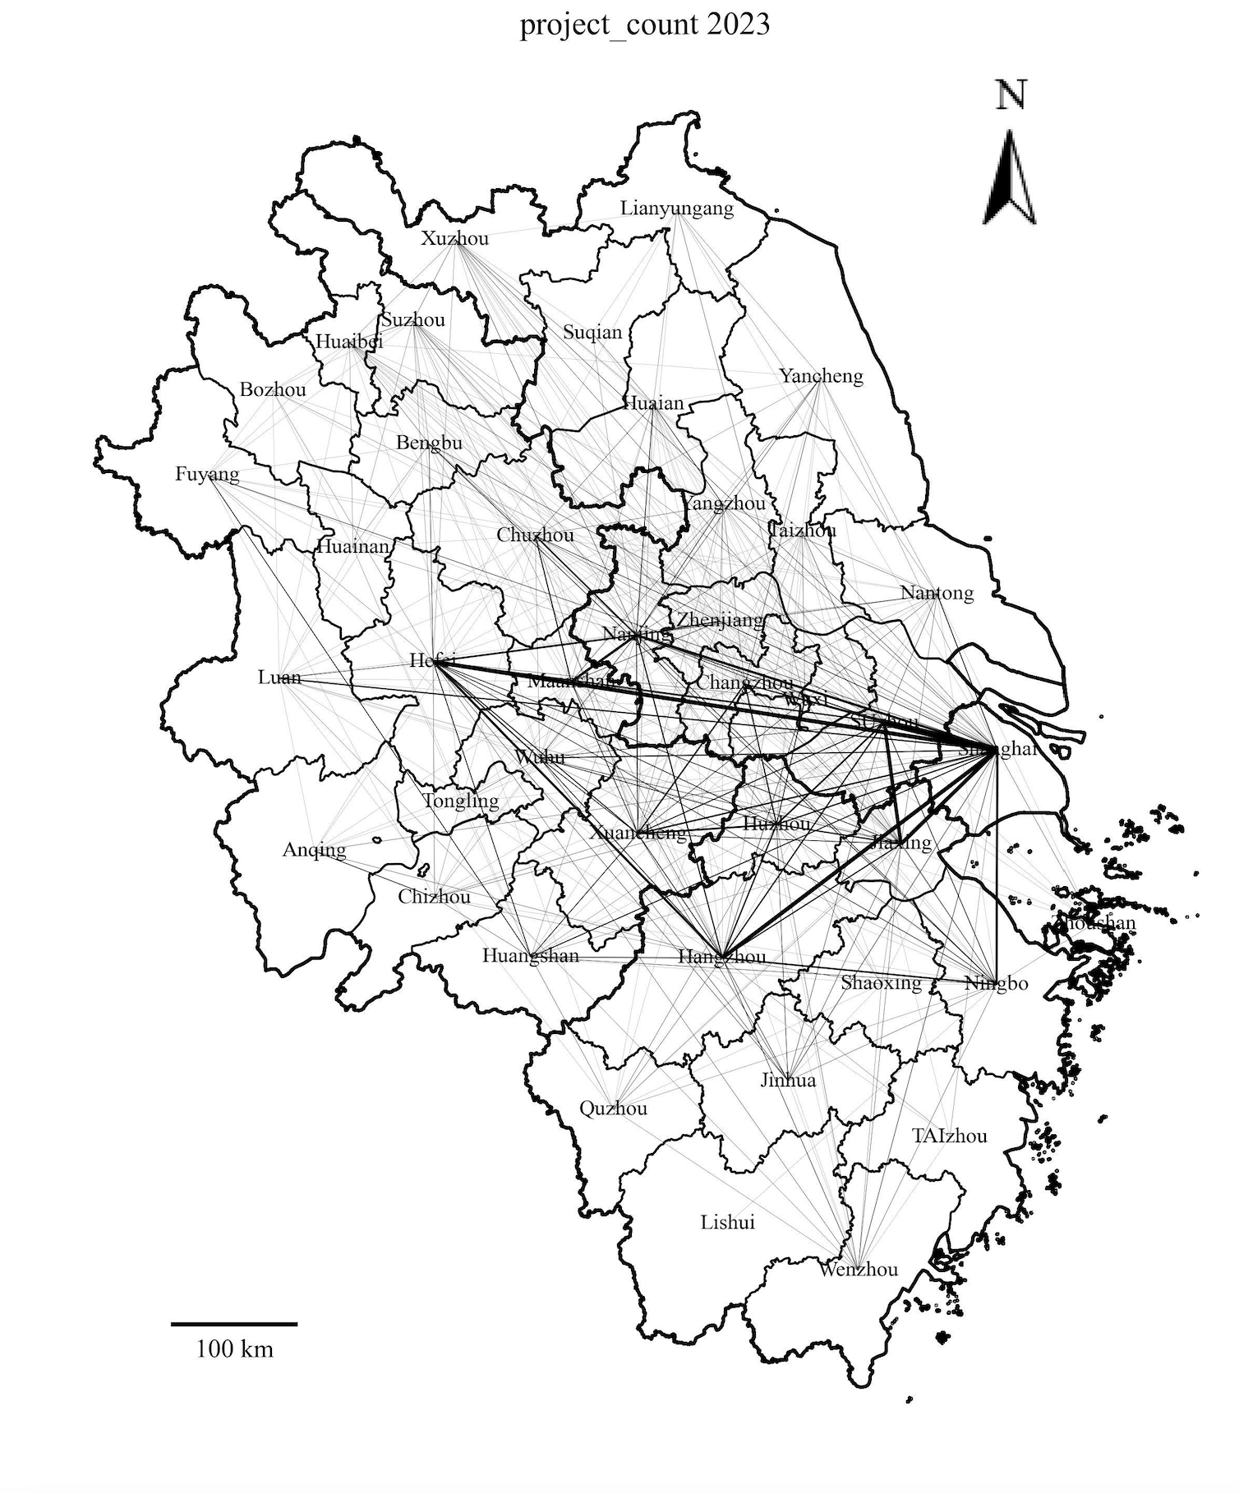
Inter-city Cooperation — Joint Project

Slide 9
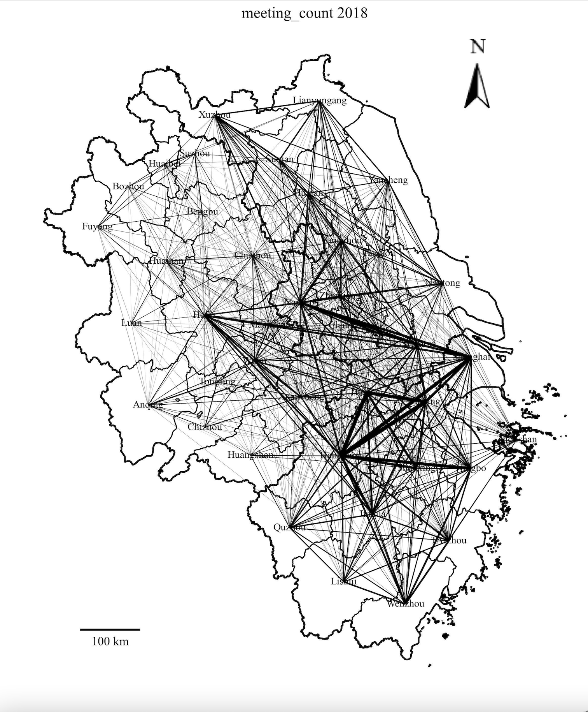
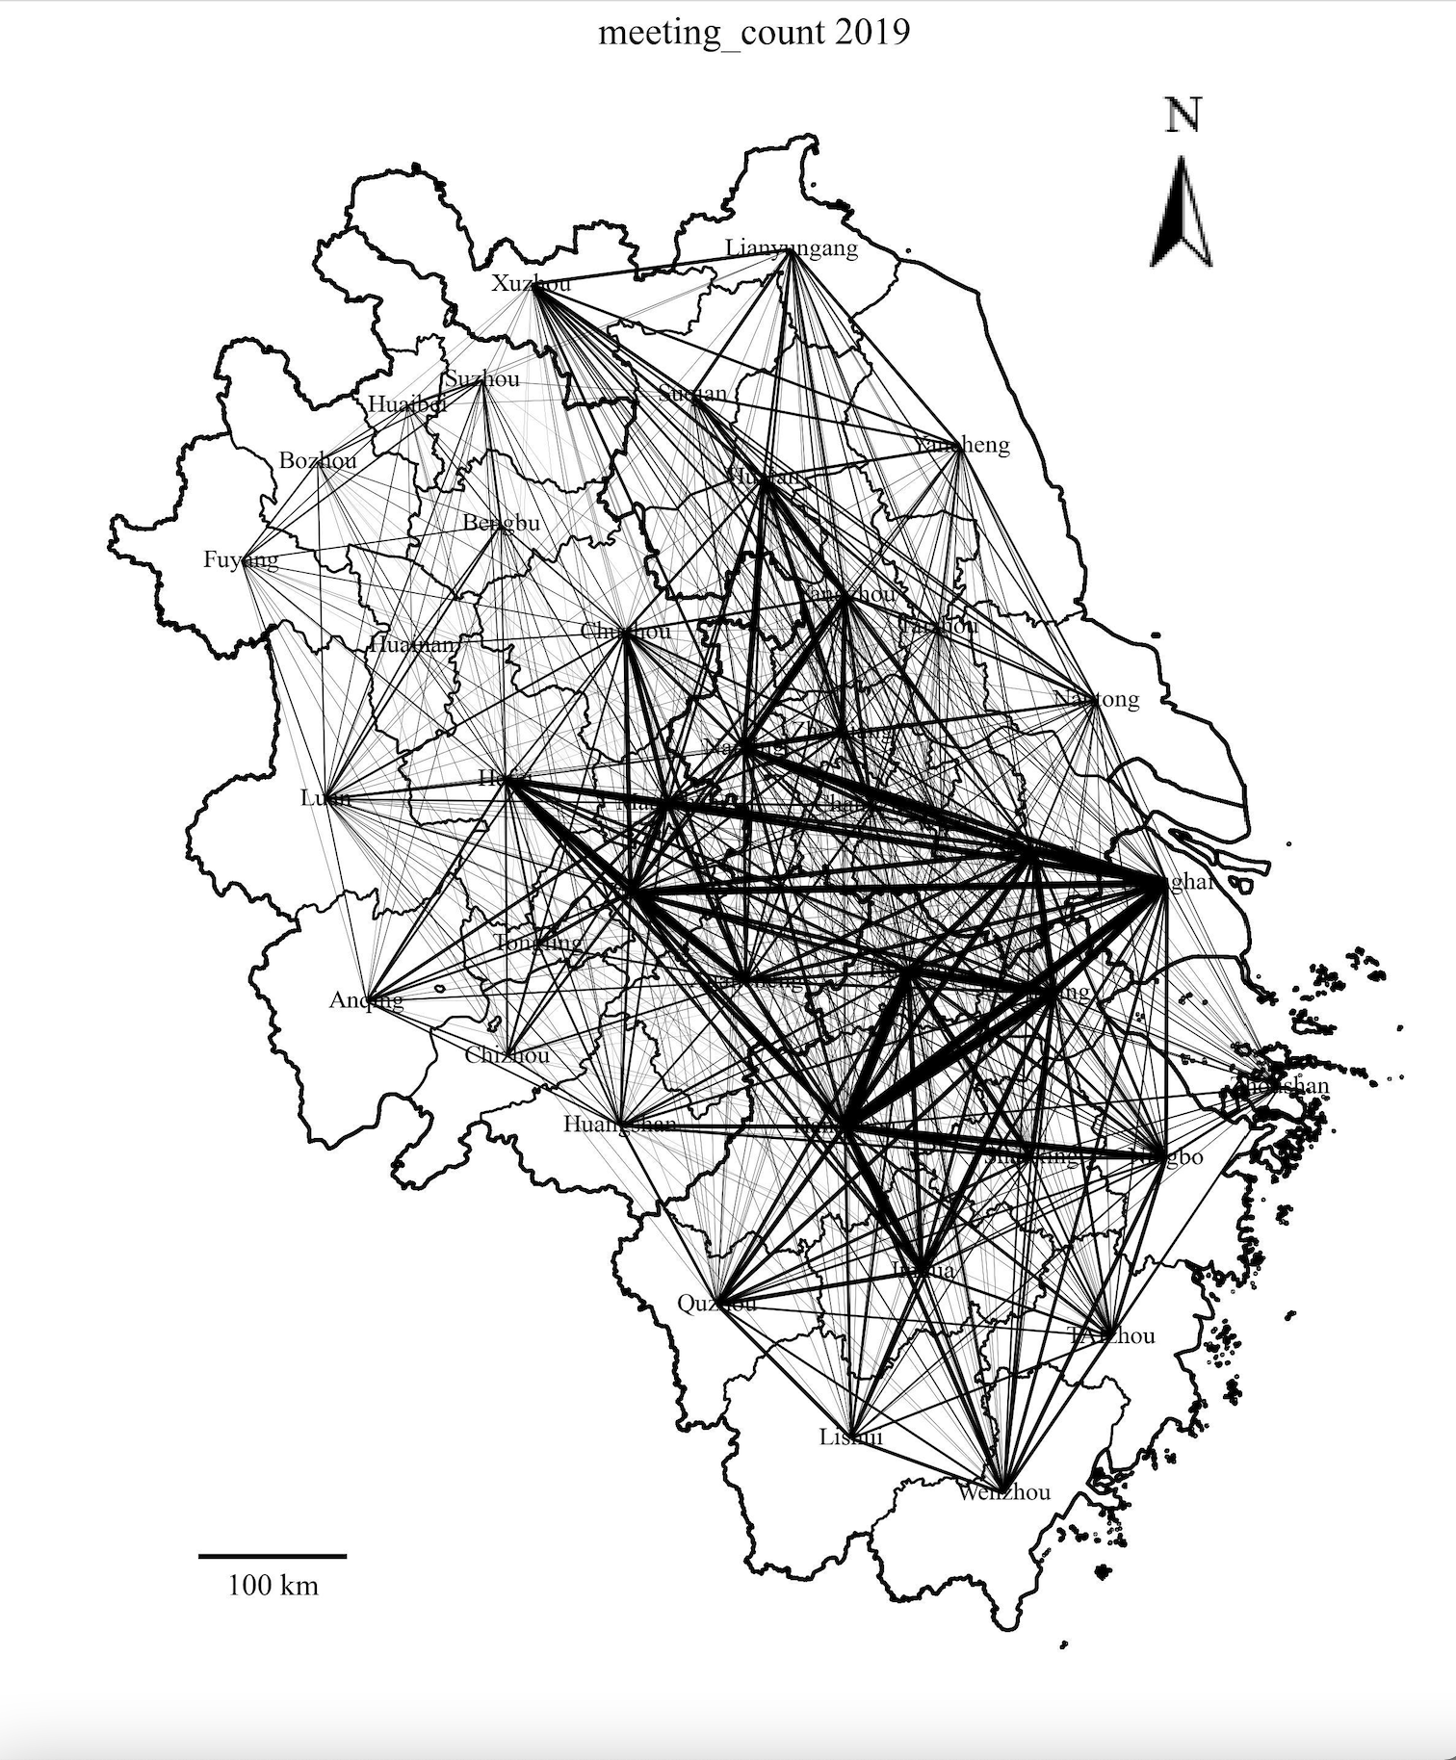
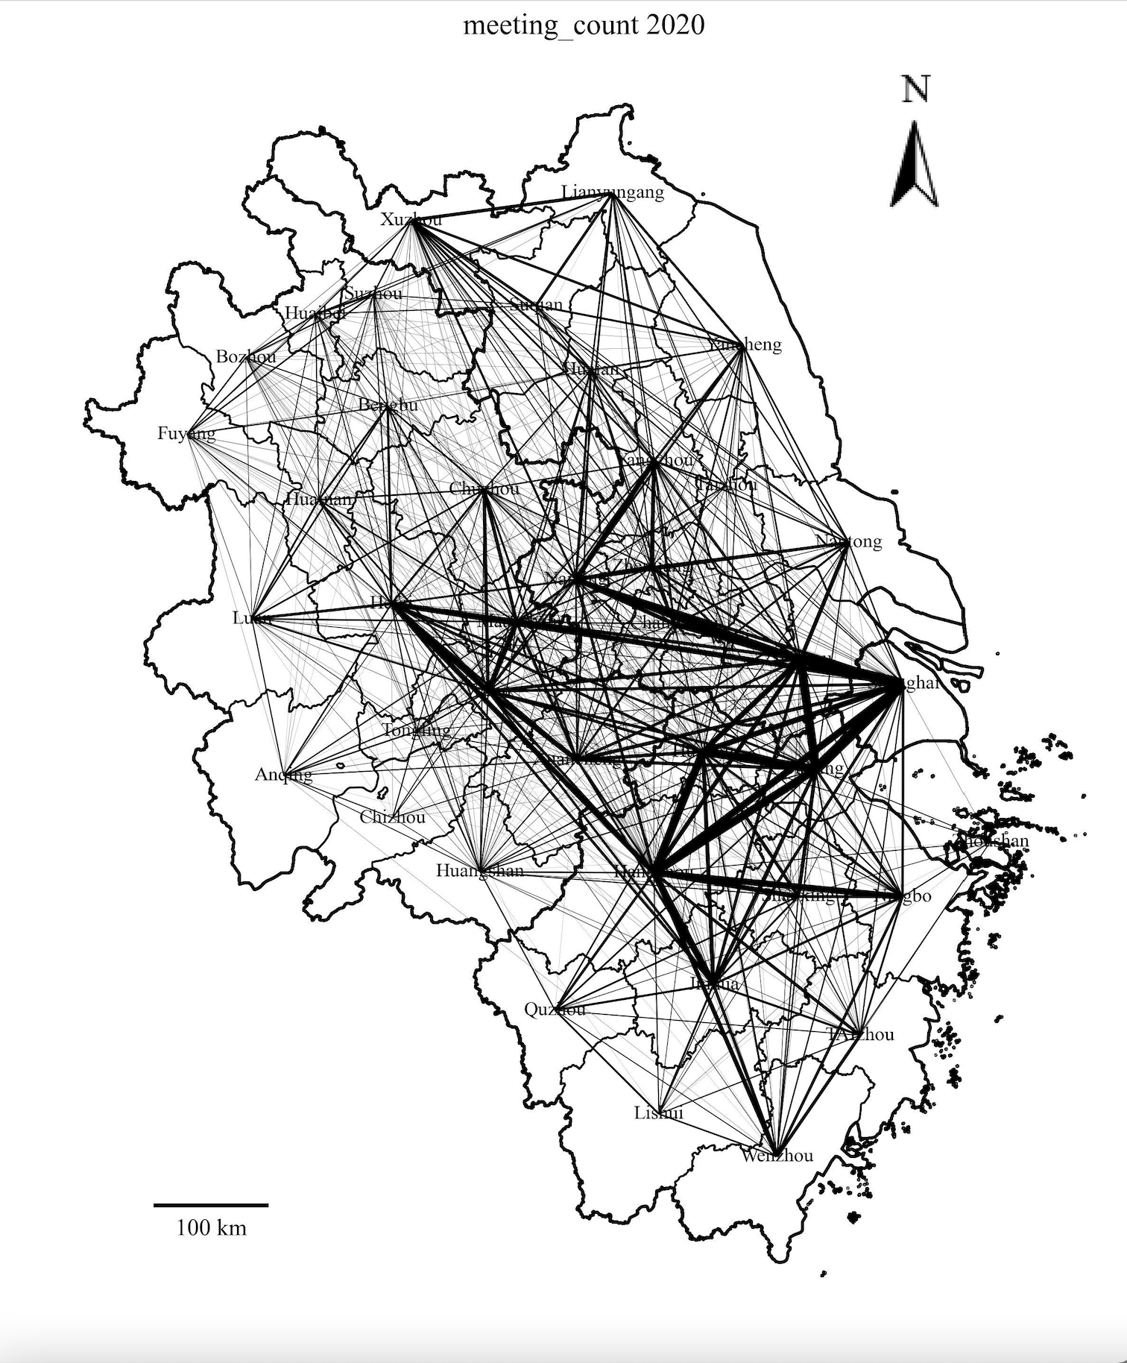
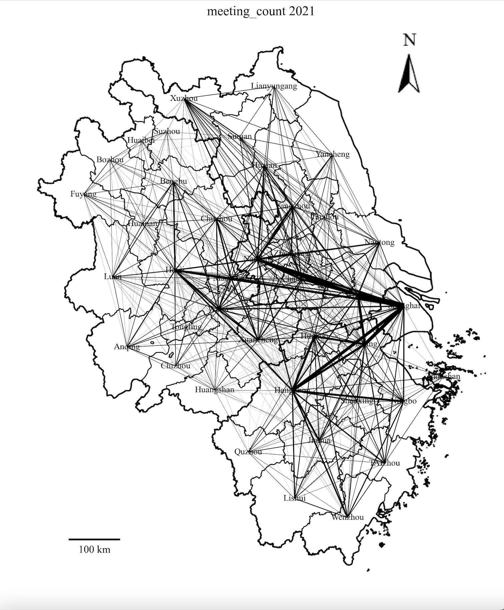
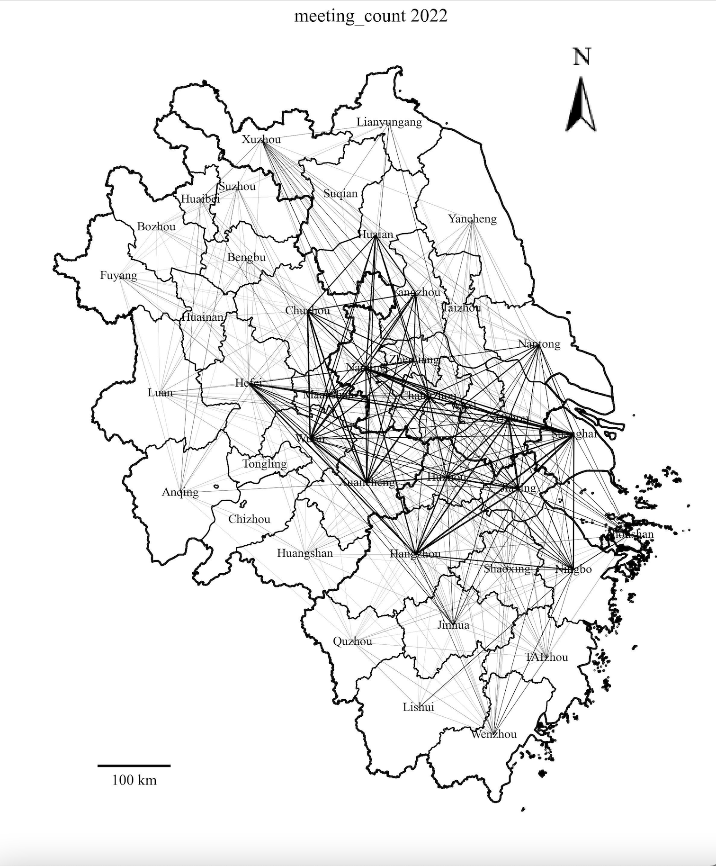
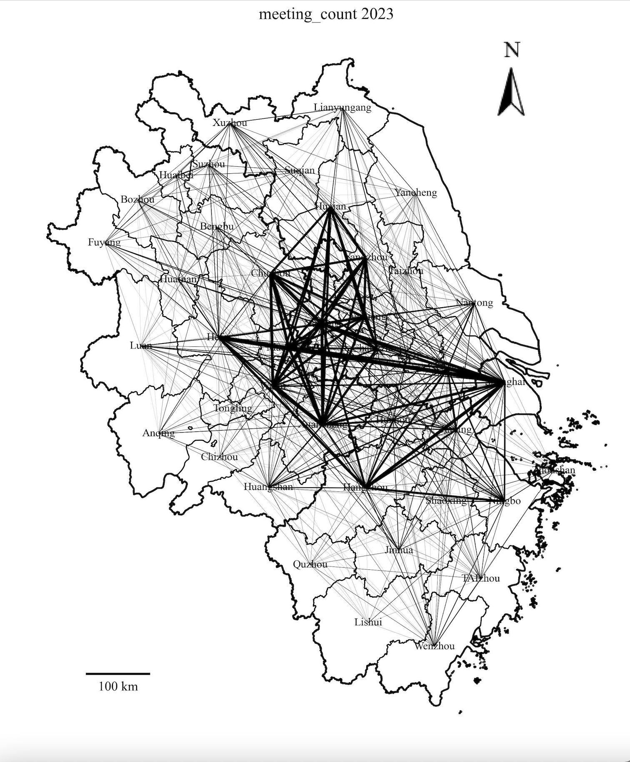
Inter-city Cooperation — Joint Meeting

Slide 10
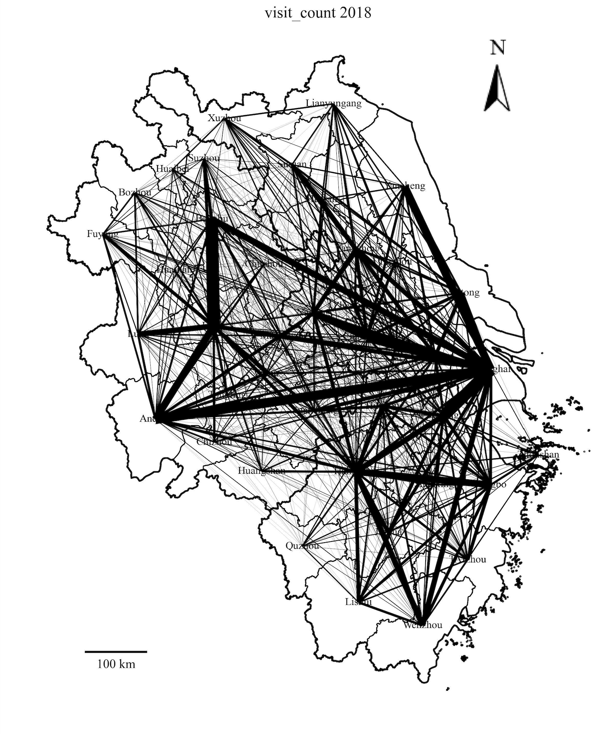
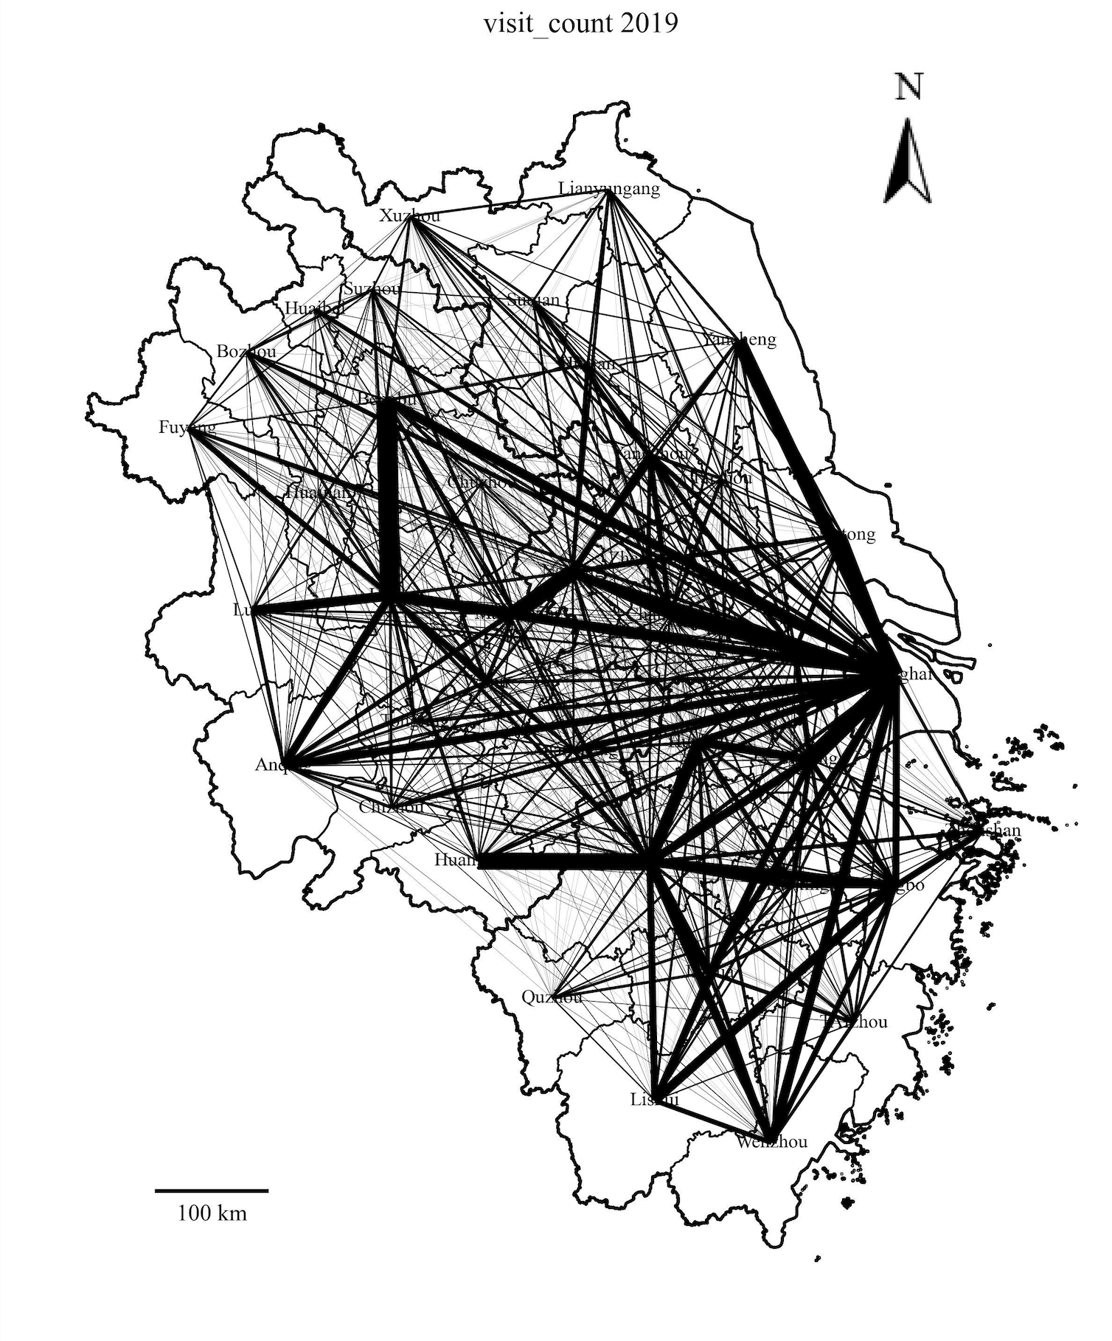
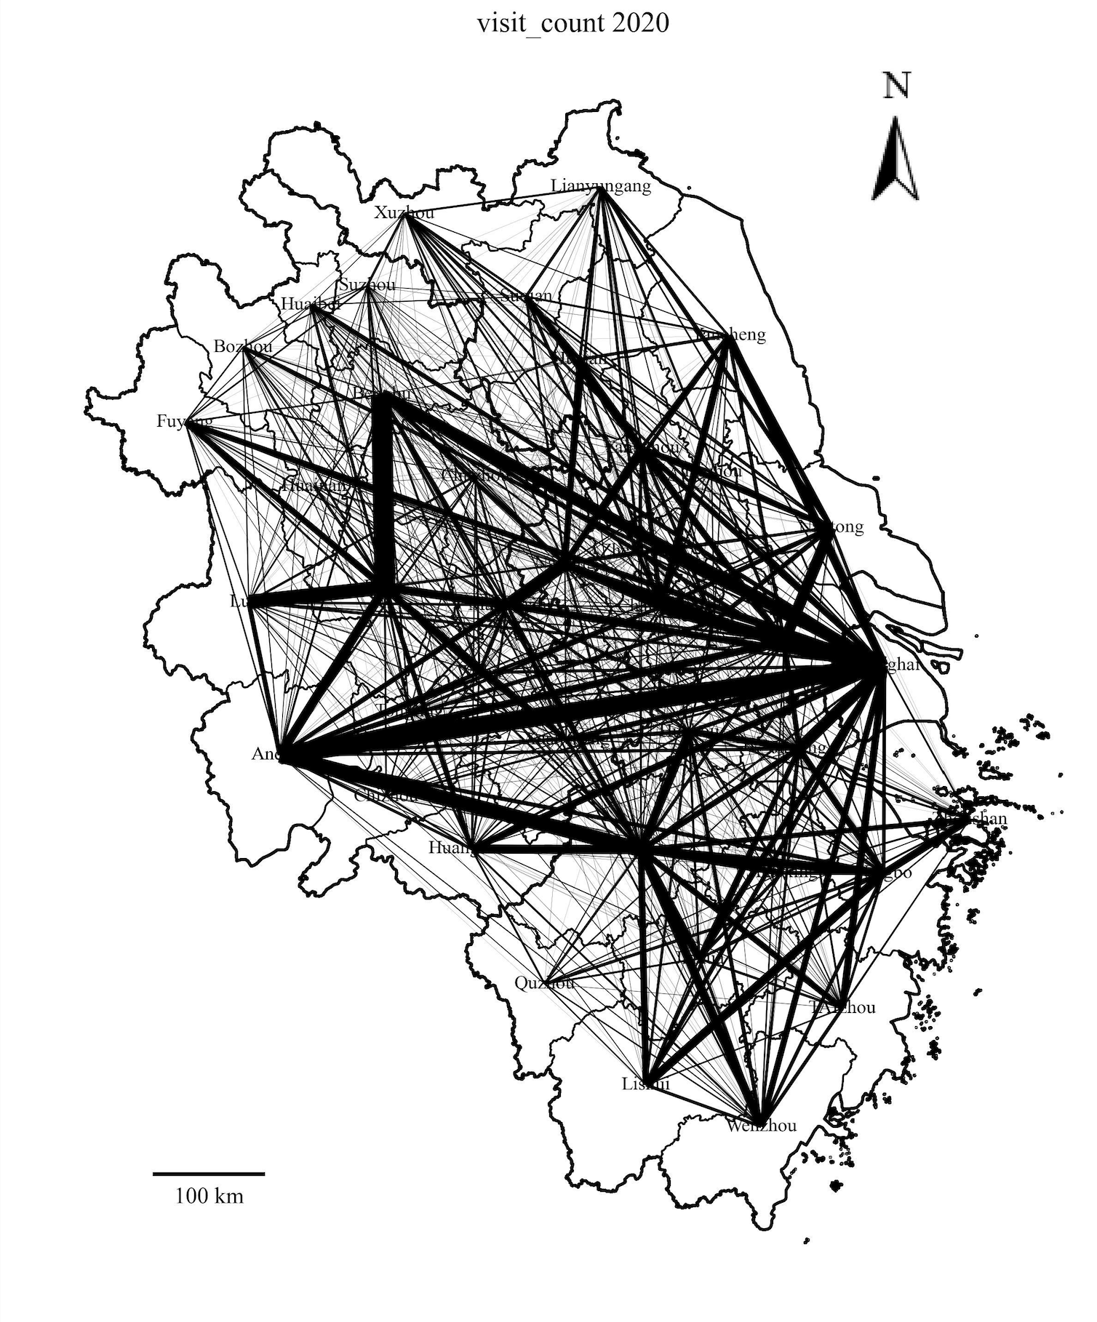
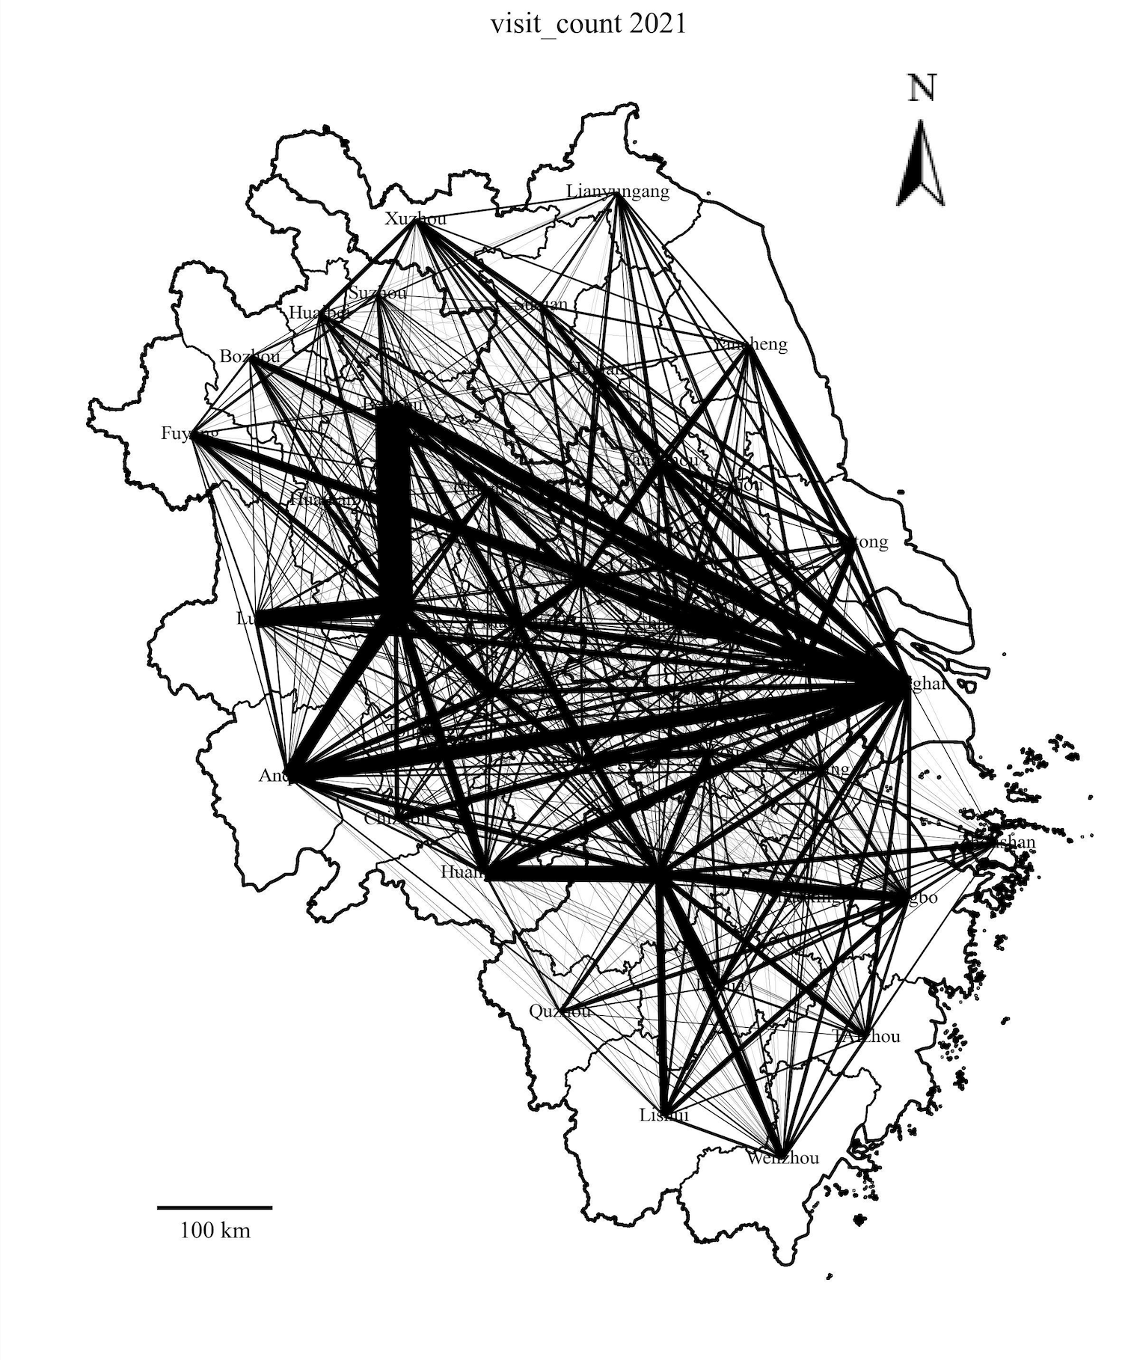
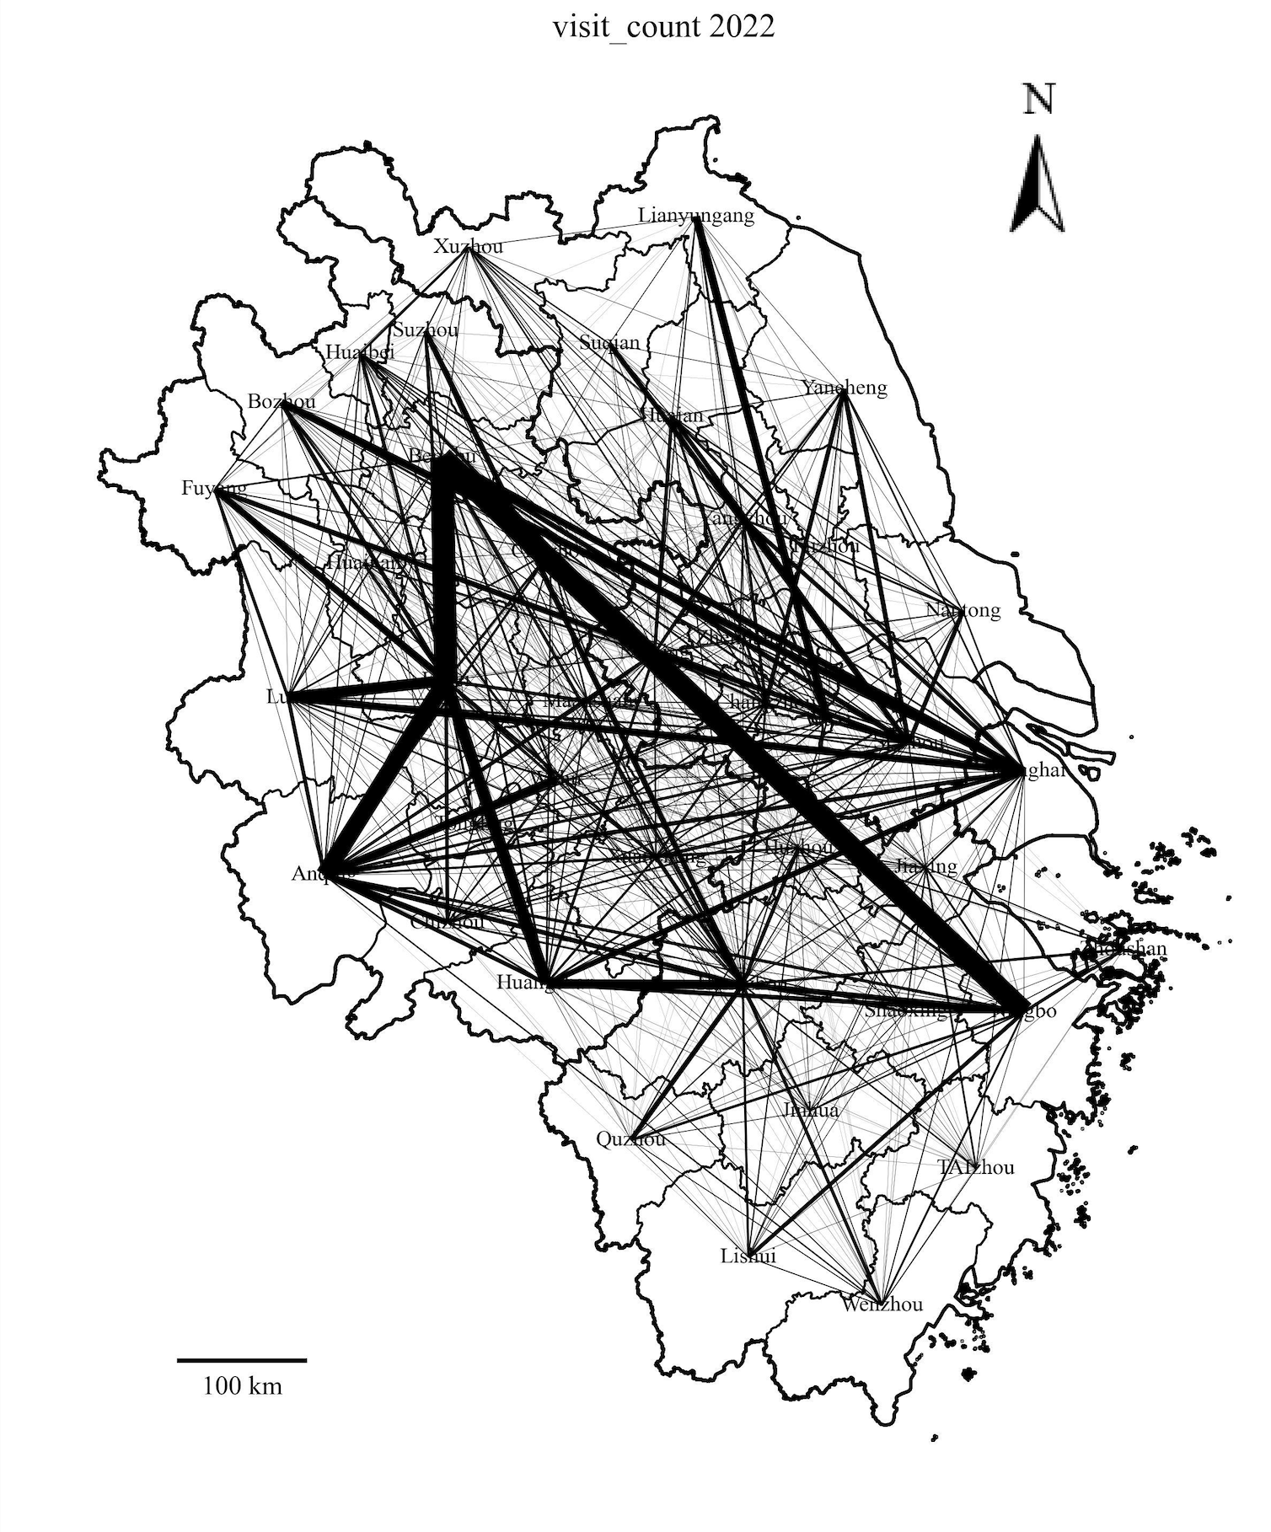
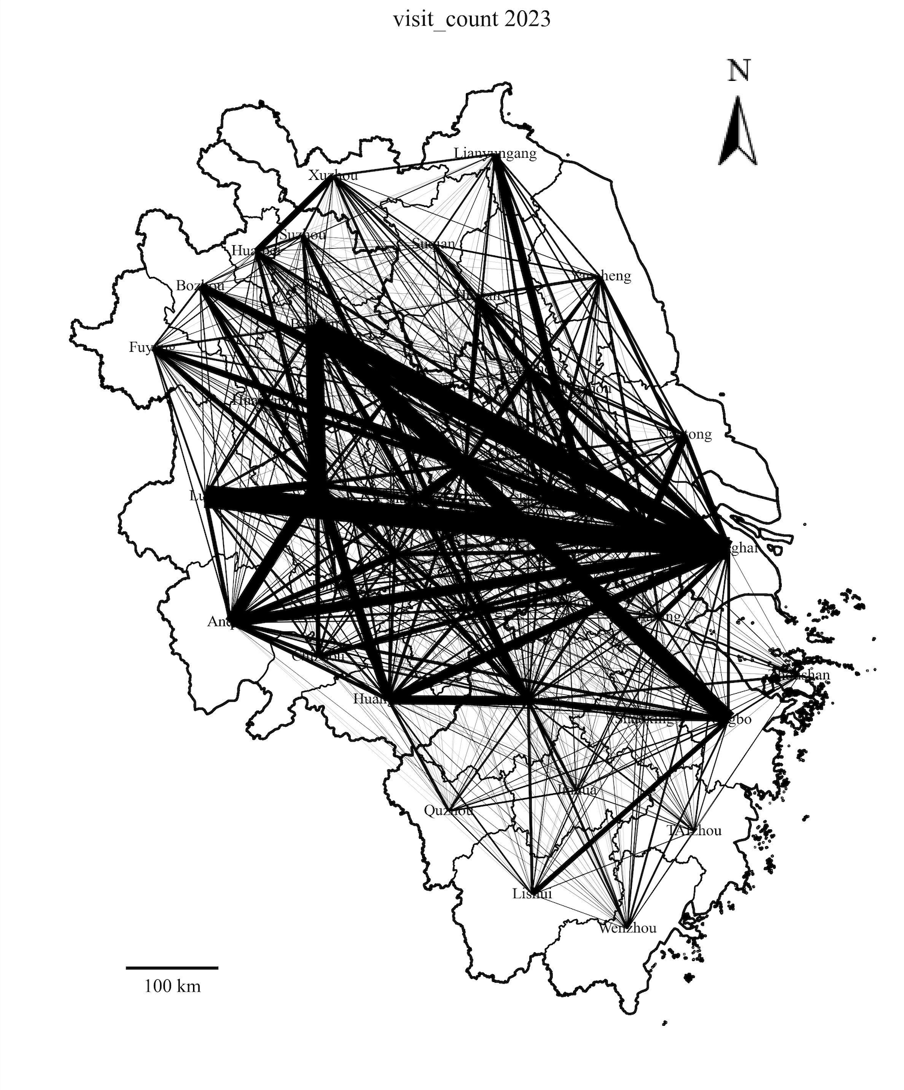
Inter-city Cooperation — Study Visit

Slide 11
Conclusion
In total, inter-city cooperation shows a increasing pattern over year along with growing migration
Different type of cooperations share same trend
COVID-19 effect: 2022-2023
Stronger tie between metro cities (Shanghai, Hangzhou, Suzhou, etc.), extending to undeveloped area
Limitation
Regression Analysis
Take socioeconomic factors into consideration
Spatial autocorrelation Yangtze River Delta

Slide 12
Thank You!

